Slide 1
Nonreciprocal Cahn-Hilliard Model
Sep, 30, 2023
Wentao Gong

Slide 2
Outline
1. Theory, Concepts and Equations
2. Discretization:Pseudo-spectral Method and High Order Time Integration for Multicomponent Phase Separation
3. Example and Results
4. References

Slide 3
1. Theory, Concepts and Equations

Slide 4
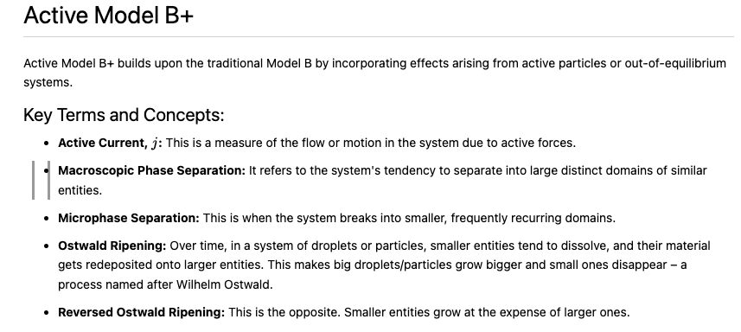

Slide 5
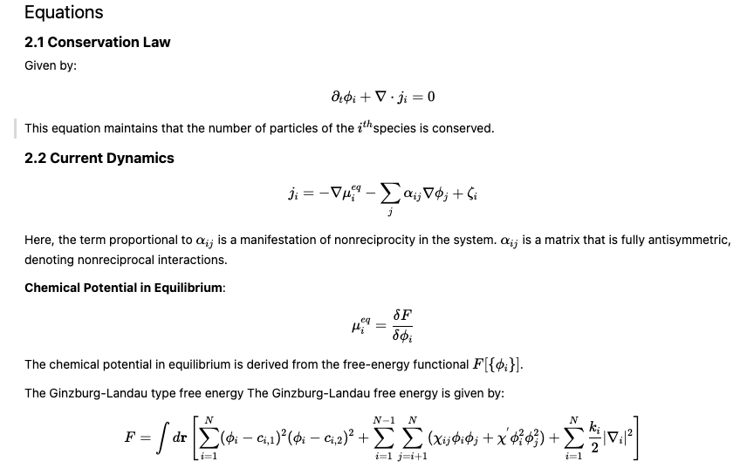

Slide 6
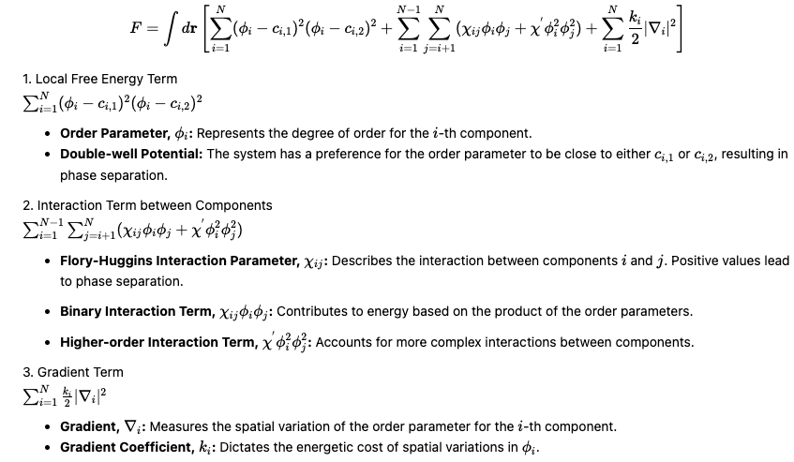

Slide 7
2. Discretization:Pseudo-spectral Method and High Order Time Integration for Multicomponent Phase Separation

Slide 8
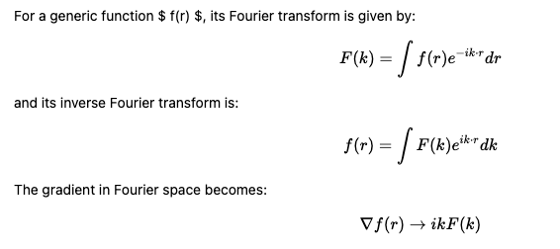
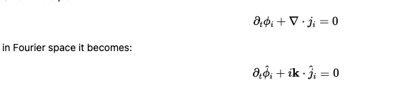
Pseudo-spectral Method and High Order Time Integration for Multicomponent Phase Separation
Pseudo-spectral Discretization in Space

Slide 9
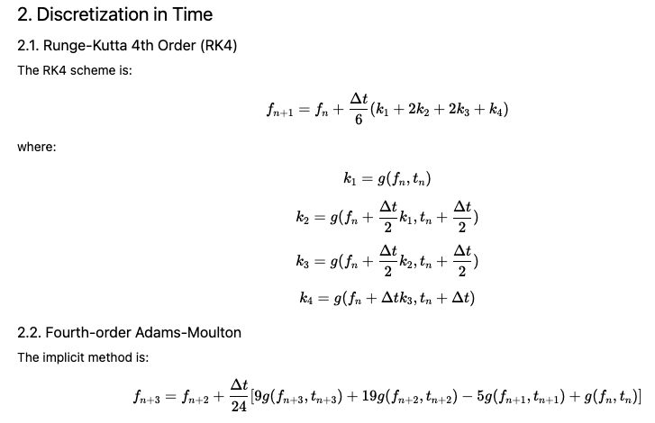

Slide 10
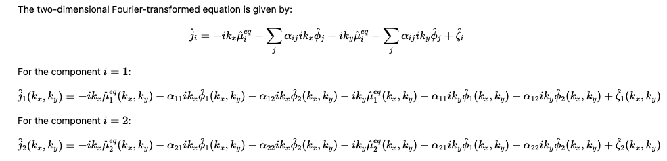
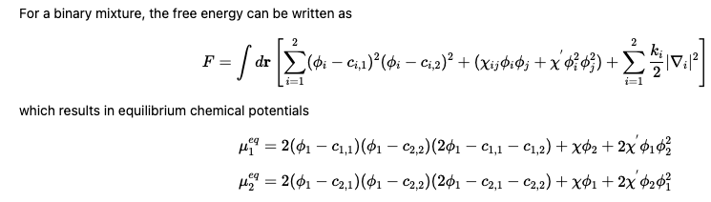

Slide 11
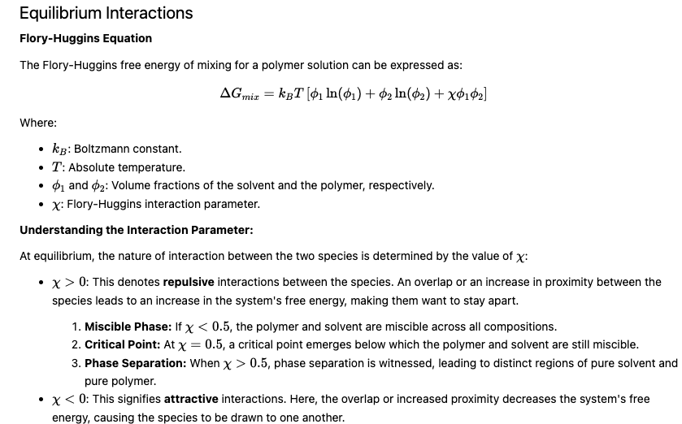

Slide 12
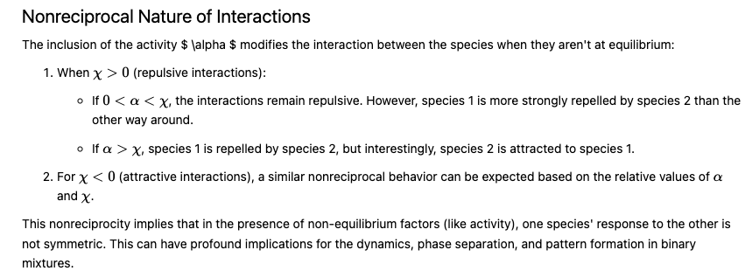

Slide 13
3. Example and Results

Slide 14
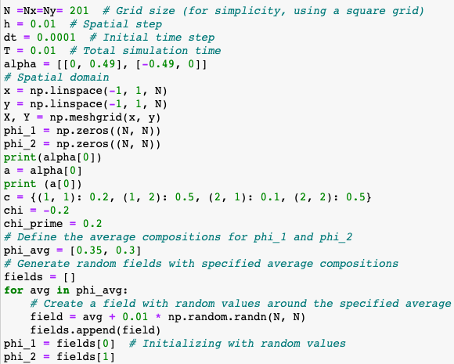
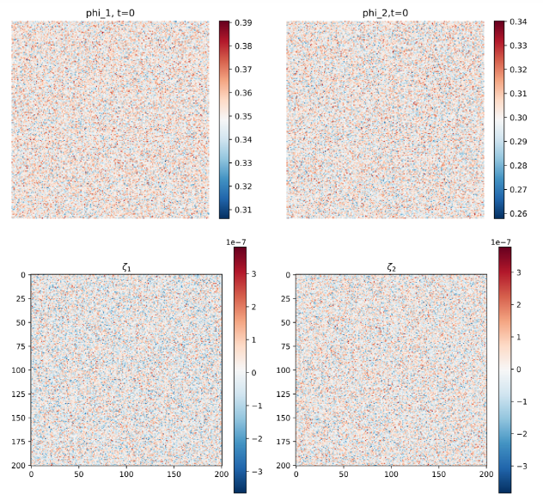
Initialization and Parameters

Slide 15
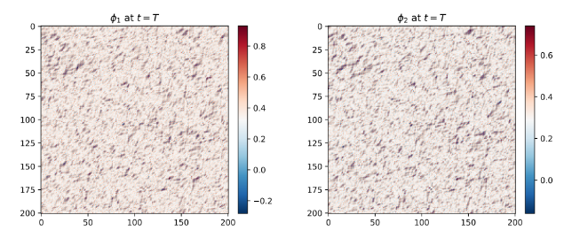

Slide 16
Reference
Saha, S., Agudo-Canalejo, J., & Golestanian, R. (2020). Scalar active mixtures: The nonreciprocal Cahn-Hilliard model. Physical Review X, 10(4), 041009.
Youtube:Self-organization in non-reciprocal active matter
https://www.youtube.com/watch?v=lMeXqQZDx3k&t=373s

